Slide 1

Programming
Chapter 8
Debug and Coding standards

Slide 2
topics
Start debug process
Execute statements, inspect variables
Debug tips
Coding convention: naming, layout, comment

Slide 3

Debugging the Code
The process of debugging application includes:
Spotting an error
Finding the lines of code that cause the error
Fixing the error in the code
Testing to check if the error is gone and no new errors are introduced
Iterative and continuous process

Slide 4
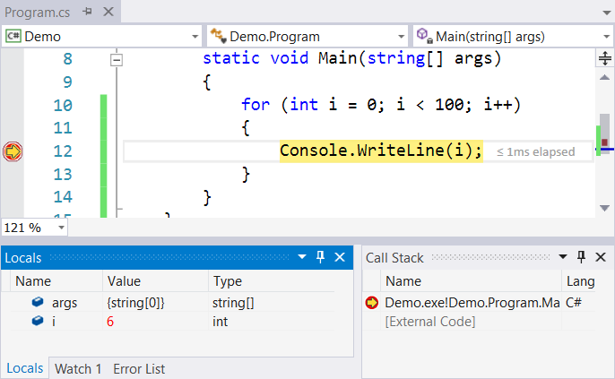
Debugging in Visual Studio
Visual Studio has a built-in debugger
It provides:
Breakpoints
Ability to trace the code execution
Ability to inspect variables at runtime

Slide 5

Navigating through Code with the Debugger
Often, you start a debugging session using F5 (Debug / Start Debugging). This command starts your app with the debugger attached.
The green arrow also starts the debugger (same as F5).
Notes:
Lý do debug

Slide 6
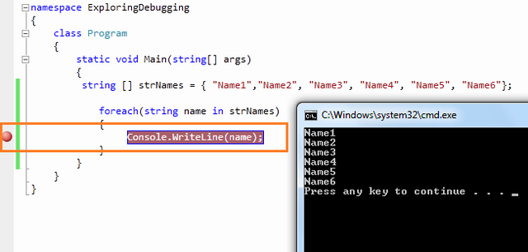
Breakpoint
Breakpoint is used to notify debugger where and when to pause the execution of program.
You can put a breakpoint in code by clicking on the side bar of code or by just pressing F9 at the front of the line.

Slide 7
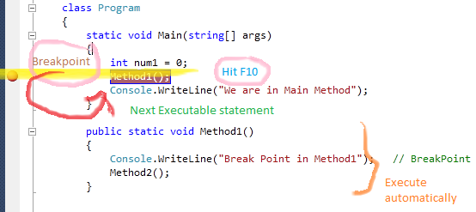
Step over
After debugger hits the breakpoint, you may need to execute the code line by line.
"Step Over" or F10 command is used to execute the code line by line.

Slide 8
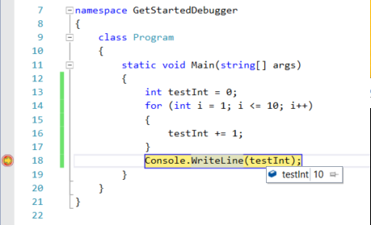
Simply Inspect Variables
You can hover over a variable to view the current value in a data tip

Slide 9
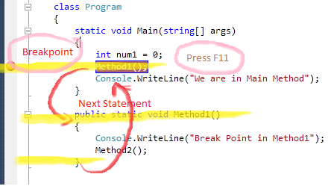
Step into
This is similar to Step Over. The only difference is, if the current highlighted section is any methods call, the debugger will go inside the method.
Shortcut key for Step Into is "F11".

Slide 10
Step out
This is related when you are debugging inside a method.
If you press the Shift - F11 within the current method, then the execution will complete the execution of the method and will pause at the next statement from where it called.

Slide 11
Run to cursor
Run to the cursor location
To run to the cursor location, place the cursor on an executable line of code in a source window. On the editor's context menu (right-click in the editor), choose Run to Cursor. This is like setting a temporary breakpoint.

Slide 12
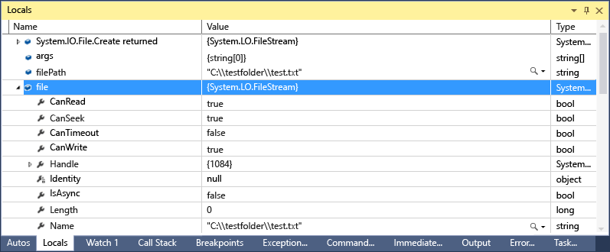
Inspect Variables
The Locals (CTRL+ALT+V,L) window displays variables that are defined in the local scope, which is generally the function or method that is currently being executed.
The Autos (CTRL+ALT+V, A) window displays variables used around the current line (the place where the debugger is stopped). Exactly which variables displayed is different in different languages

Slide 13
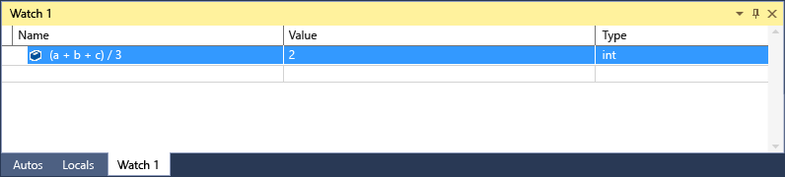
INSPECT VARIABLES
You can use the Watch (Debug / Windows / Watch / Watch (1, 2, 3, 4)) and QuickWatch (right-click on variable / Debug / QuickWatch) windows to watch variables and expressions during a debugging session.
The difference is that the Watch window can display several variables, while the QuickWatch window displays a single variable at a time.

Slide 14
DEBUG TIPS
Determine potential error area. Set breakpoint before enter it
Use Step Over if you are really sure that function is correct, otherwise use Step Into
Use Step Out if you are really sure that the rest of function is correct, otherwise use Step Over / Step Into
Remove unnecessary breakpoints to skip “clear” areas.

Slide 15
references
https://www.codeproject.com/Articles/79508/Mastering-Debugging-in-Visual-Studio-A-Beginn
https://msdn.microsoft.com/en-US/library/k0k771bt.aspx

Slide 16
Coding standard

Slide 17
Goal: Self-Documenting Code
Self-documenting explains itself without need for external documentation, like flowcharts, UML diagrams, process-flow diagrams, etc.
Doesn’t imply we don’t like/use those documents!
Coding conventions target:
How you write statements in the language, organize them into “modules,” format them in the source files
How you create names
How you write comments

Slide 18
Coding Conventions Apply To…
Comments, 3 types:
File headers
Function headers
Explanations of variables and statements
Names (chosen by programmer)
Statements
Organization: files, “modules,” nesting
Format: spacing and alignment

Slide 19
Naming convention
Names representing types must be in mixed case starting with upper case.
Line, SavingsAccount
Variable names must be in mixed case starting with lower case.
line, savingsAccount
Named constants (including enumeration values) must be all uppercase using underscore to separate words.
MAX_ITERATIONS, COLOR_RED, PI
Names representing methods or functions must be verbs and written in mixed case starting with upper case.
GetName(), ComputeTotalWidth()

Slide 20
Naming convention
Variables with a large scope should have long names, variables with a small scope can have short names
The name of the object is implicit, and should be avoided in a method name.
line.getLength(); // NOT: line.getLineLength();

Slide 21
Naming convention
Plural form should be used on names representing a collection of objects.
The prefix n should be used for variables representing a number of objects.
The suffix No should be used for variables representing an entity number.
vector<Point> points;
int values[];
nPoints, nLines
tableNo, employeeNo

Slide 22
Naming convention
Use prefix is / has / can for functions return boolean values
Complement names must be used for complement operations.
Functions should be named after what they return and procedures should be named after what they do..
bool hasLicense();
bool canEvaluate();
bool isSorted();
get/set, add/remove, create/destroy, start/stop, insert/delete
int getAge();
void print();

Slide 23
Statement convention
Type conversions must always be done explicitly. Never rely on implicit type conversion.
Complex conditional expressions should be avoided.
floatValue = (float) intValue; // NOT: floatValue = intValue;
bool isFinished = (elementNo < 0) || (elementNo > maxElement); bool isRepeatedEntry = elementNo == lastElement;
if (isFinished || isRepeatedEntry)
{ ... }

Slide 24
Statement convention
Floating point constants should always be written with decimal point and at least one decimal.
double total = 0.0F; // NOT: double total = 0;
double speed = 3.0F; // NOT: double speed = 3; double sum = (a + b) * 10.0F;

Slide 25
Layout
Makes lines at same level of nesting stand out.
if ( flag == 0 ) {
var1 = 0;
if ( var2 > level1 ) {
var2 = level1;
level1 = 0;
}
printf ( "%d/n", var2 );
}

Slide 26
Layout
White Space
a = (b + c) * d; // NOT: a=(b+c)*d
while (true) // NOT: while(true)
doSomething(a, b, c, d); // NOT: doSomething(a,b,c,d);
for (i = 0; i < 10; i++) { // NOT: for(i=0;i<10;i++){

Slide 27
Layout
Logical units within a block should be separated by one blank line.
Matrix4x4 matrix = new Matrix4x4();
double cosAngle = Math.cos(angle);
double sinAngle = Math.sin(angle);
matrix.setElement(1, 1, cosAngle);
matrix.setElement(1, 2, sinAngle);
matrix.setElement(2, 1, -sinAngle);
matrix.setElement(2, 2, cosAngle);
multiply(matrix);

Slide 28
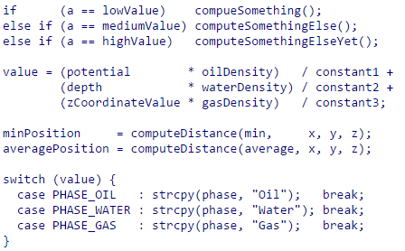
Layout
Use alignment wherever it enhances readability.

Slide 29
Comments
File header: explain content of file
Function header: explain content of function, parameters, return values, exceptions.
Variables: Meaning of variable, usability
Statements: Only if it’s necessary (complex formula, detailed protocol, special business process, …)

Slide 30
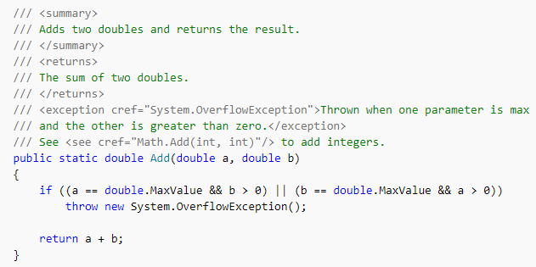
Xml document comment
C# XML commenting

